Slide 1
Prediction of the Concentration of One Ion Using the Concentration of Other Ions in Rainwater Samples Practical Project on Regression Data Science
Ellaine Gellie Nicdao

Slide 2
Content
Introduction
Objective
Overview
Pre-processing and EDA
Linear Regression
Multivariable Linear Regression
Conclusion

Slide 3
Introduction
Ions
Anions (-)
Chloride ion (Cl⁻)
Nitrate ion (NO₃⁻)
Cations (+)
Ammonium ion (NH₄⁺)
Analytes
Sulfate ion (SO₄²⁻)
Sodium ion (Na⁺)
Potassium ion (K⁺)
Calcium ion (Ca²⁺)
Magnesium ion (Mg²⁺)
Methods
Ion Chromatography
Colorimetric
Inductively Coupled Plasma – Optical Emission Spectroscopy method
Notes:
In my previous work in the laboratory, we were assigned to measure 8 specific analytes. These are…. They were analyzed using the respective methods shown. For eme they are analyzed using eme. In the laboratory we were required to meet certain quality control criteria for each of the analytes. The problem is if the criteria for one of the analytes is not met. Then, we have to repeat the whole analysis.

Slide 4
Objectives
To determine if there is a correlation between the concentration of the ions analyzed for rainwater samples
To determine if the concentration of other ions can be used to predict the concentration of another ion

Slide 5
Overview
This project presents how linear regression can be used to predict the concentration of an ion using the concentration of other ions. The files used are annual rainwater concentration data (downloaded per year) from the year 2010 to 2019 from Participating East Asian countries incl. the Philippines. Each file contains `Country`, `Name of Site`, `Average Precipitation Amount`, and the average concentration of the mentioned ions. The files are downloaded from this link: https://monitoring.eanet.asia/document/public/index
Notes:
Publicly available naman yung data so di siya confidentia;

Slide 6
Preprocessing and EDA

Slide 7
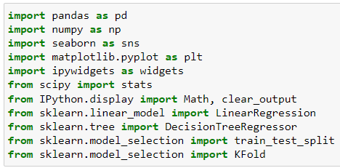
Import Necessary Libraries

Slide 8
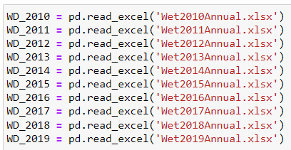
Import Dataset
Already “cleaned” separate excel files prior to importing (e.g., ensure files have same columns, remove empty rows, etc.)

Slide 9
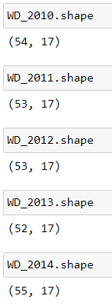
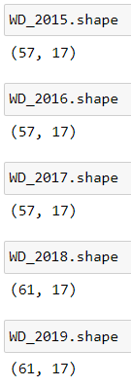
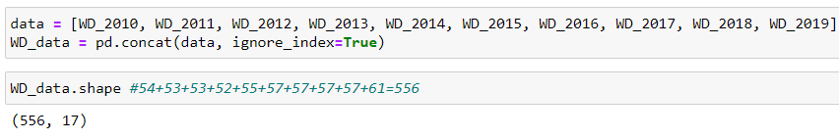
Import Dataset

Slide 10
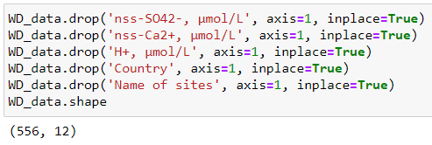
Data Processing
Deleted unnecessary columns

Slide 11
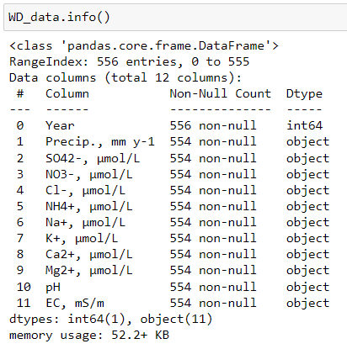
Data Processing

Slide 12
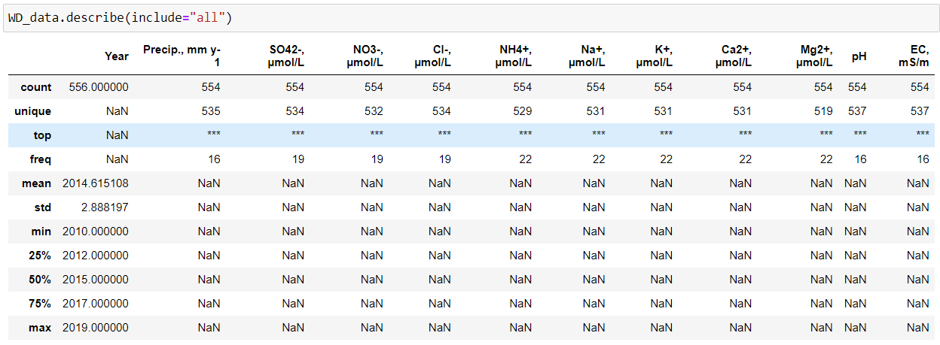
Data Processing

Slide 13
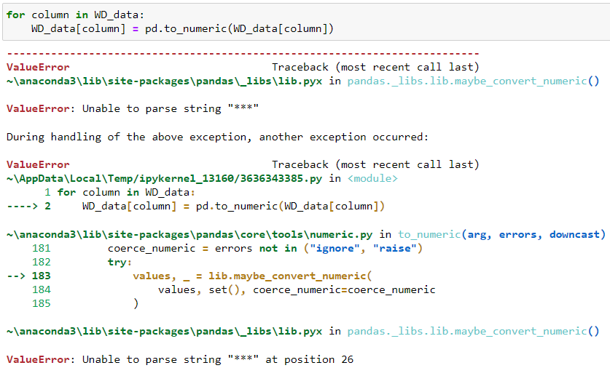
Data Processing

Slide 14
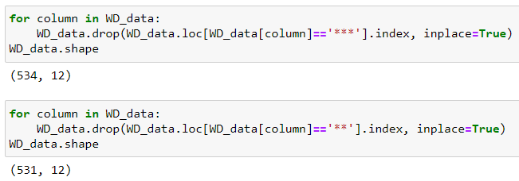
Data Processing
The error still persists, so I checked for the unique values of those columns with error, then, removed the rows with values that cannot be converted to numbers.

Slide 15

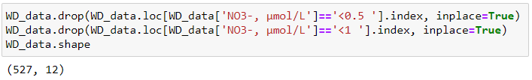

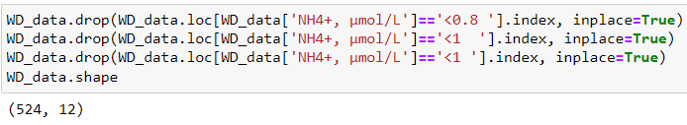

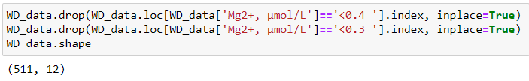
Data Processing

Slide 16
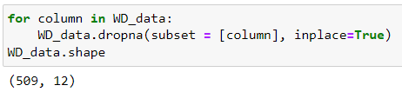

Data Processing

Slide 17
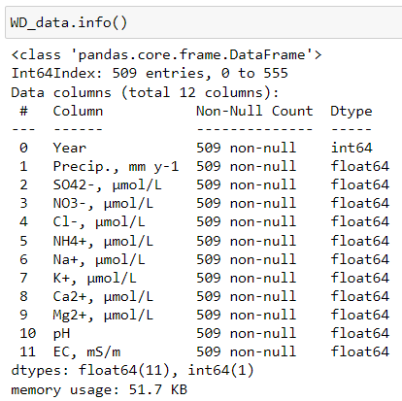
EDA

Slide 18
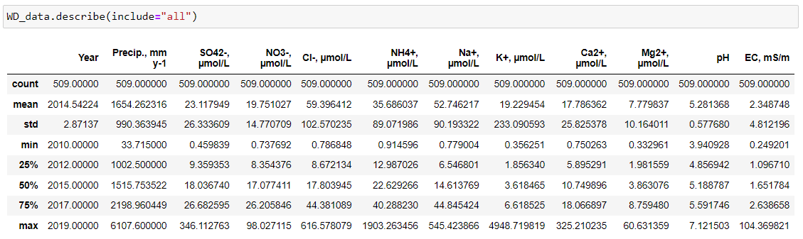
EDA

Slide 19
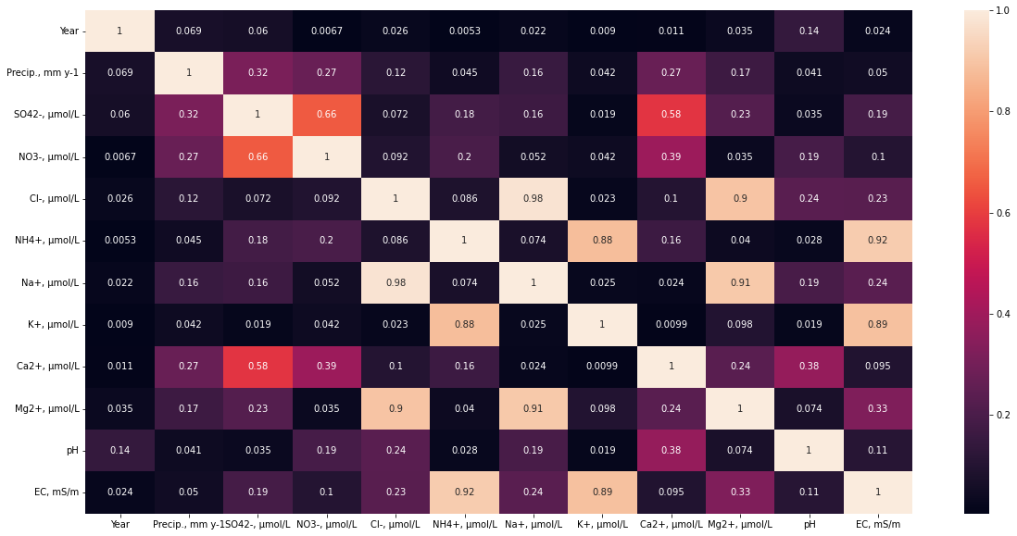

Visualization
Notes:
I based yung analyte na ippredict sa pinakamahirap ianalyze.

Slide 20
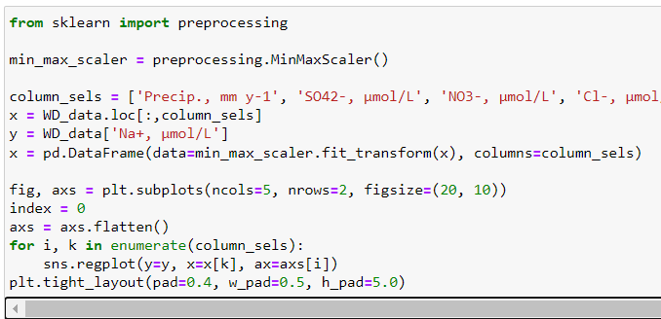
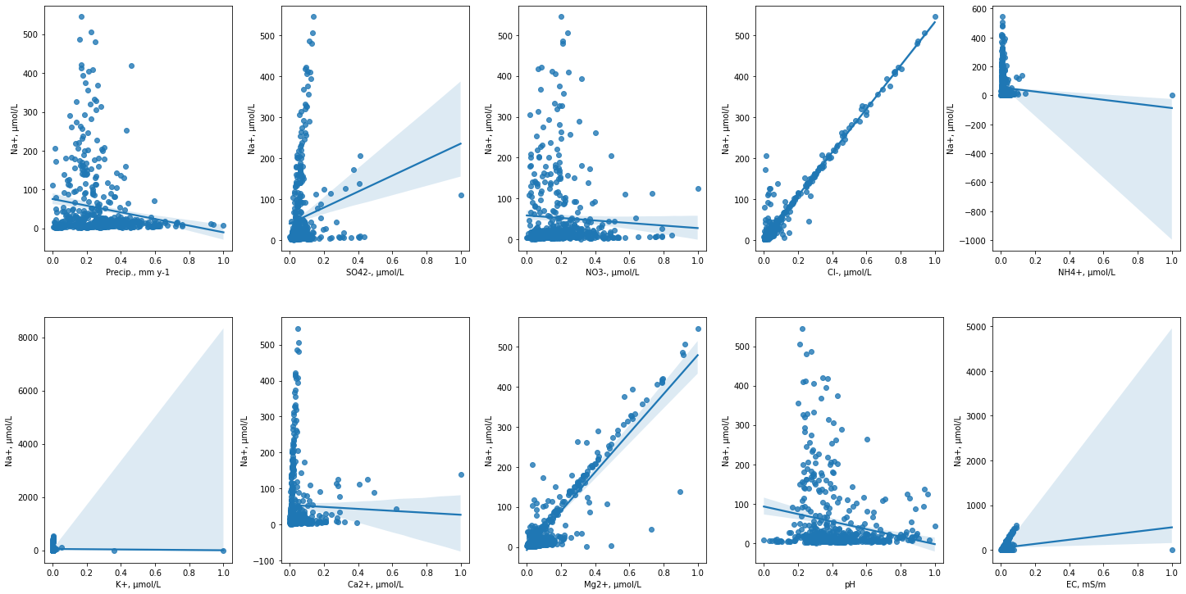
Visualization

Slide 21
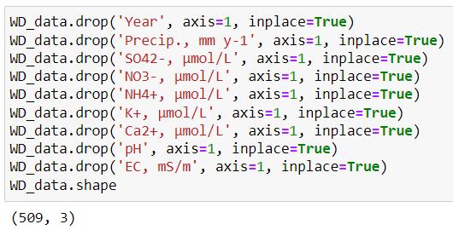
Visualization

Slide 22
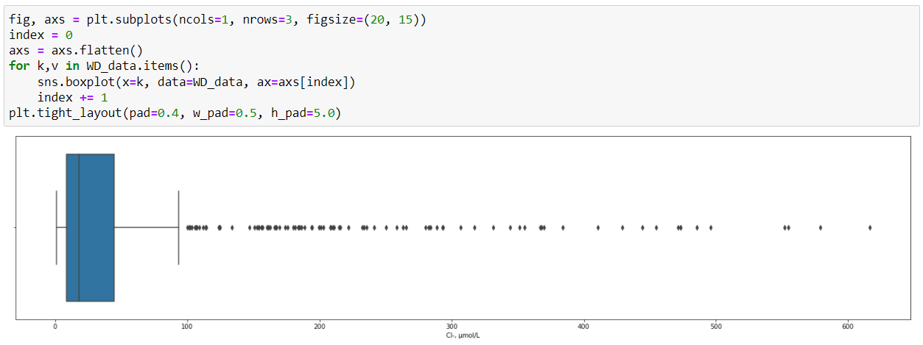
Visualization

Slide 23
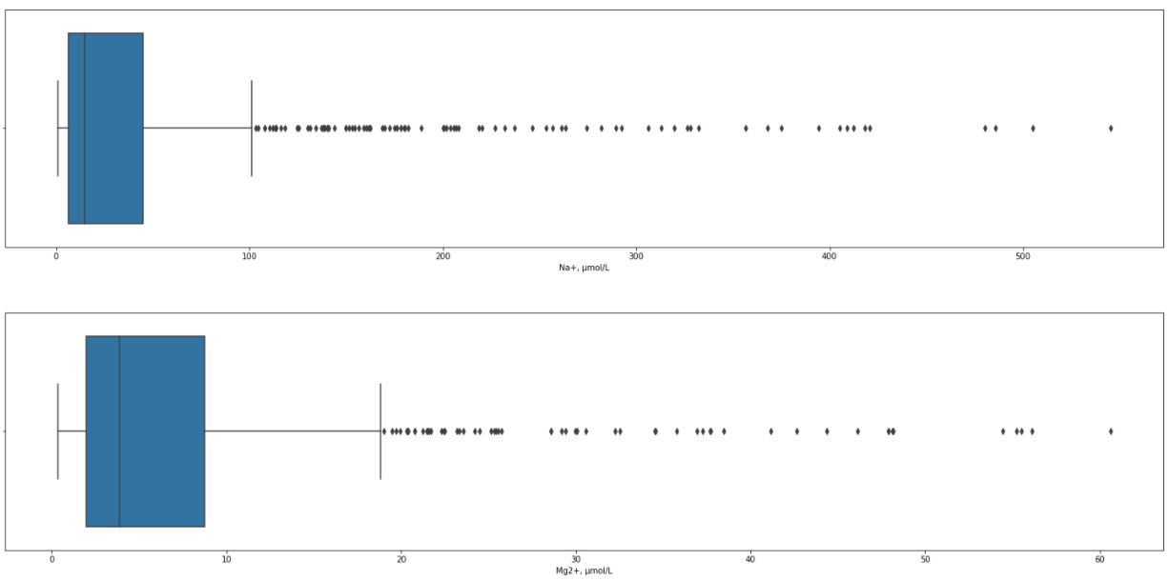
Visualization

Slide 24
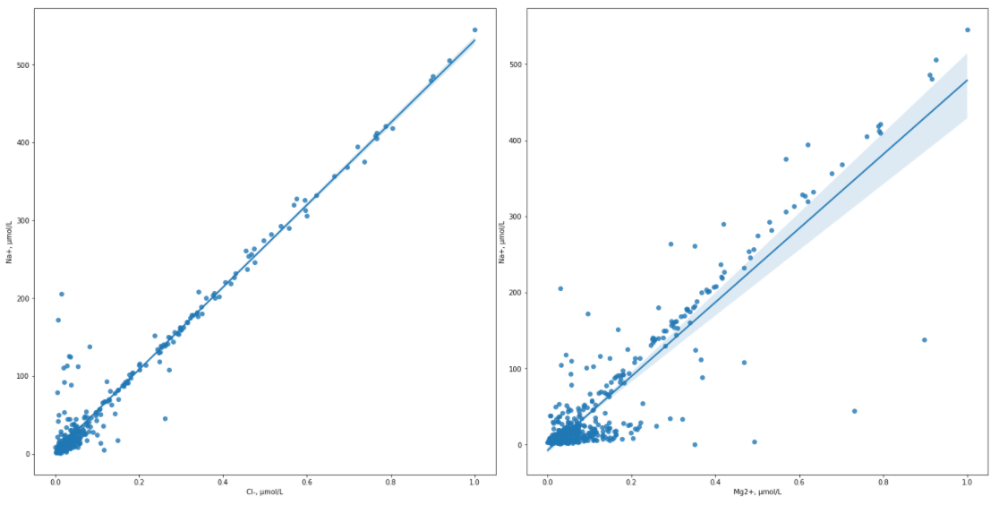
Visualization

Slide 25
Linear Regression

Slide 26
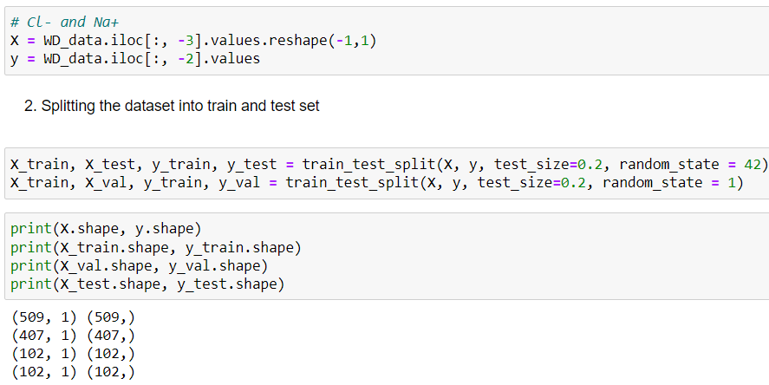
Define the Independent and Dependent Variable and Splitting the Dataset into Train, Validation and Test Set

Slide 27
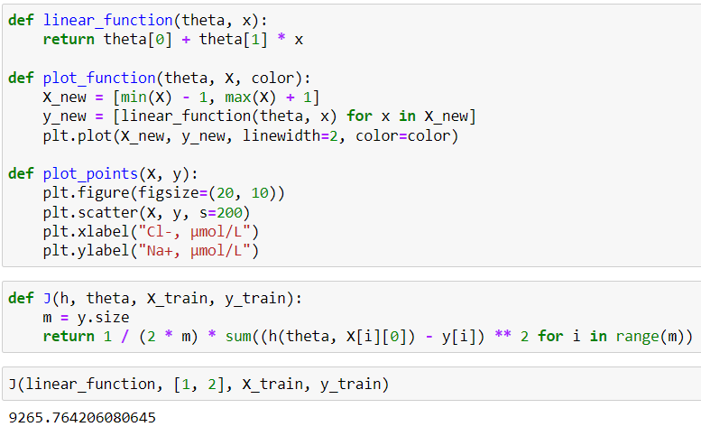
Define the Independent and Dependent Variable

Slide 28
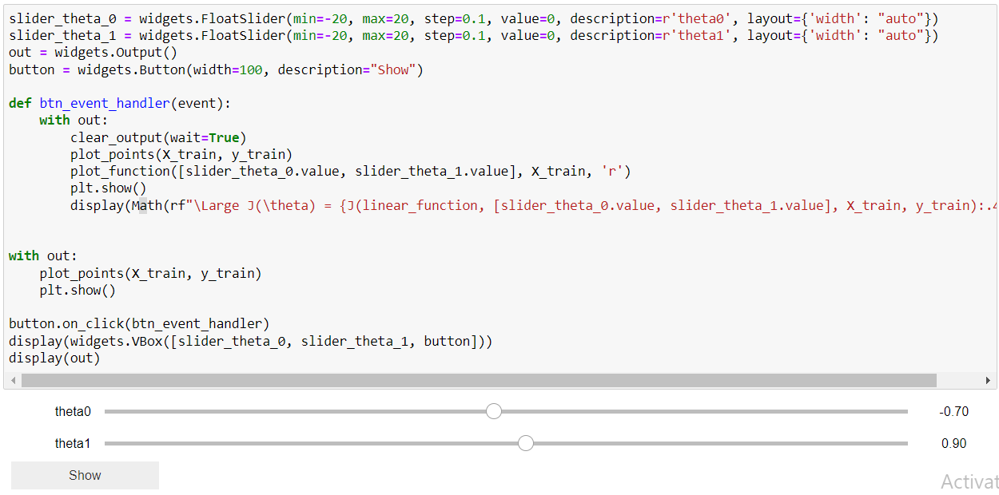
Define the Independent and Dependent Variable

Slide 29
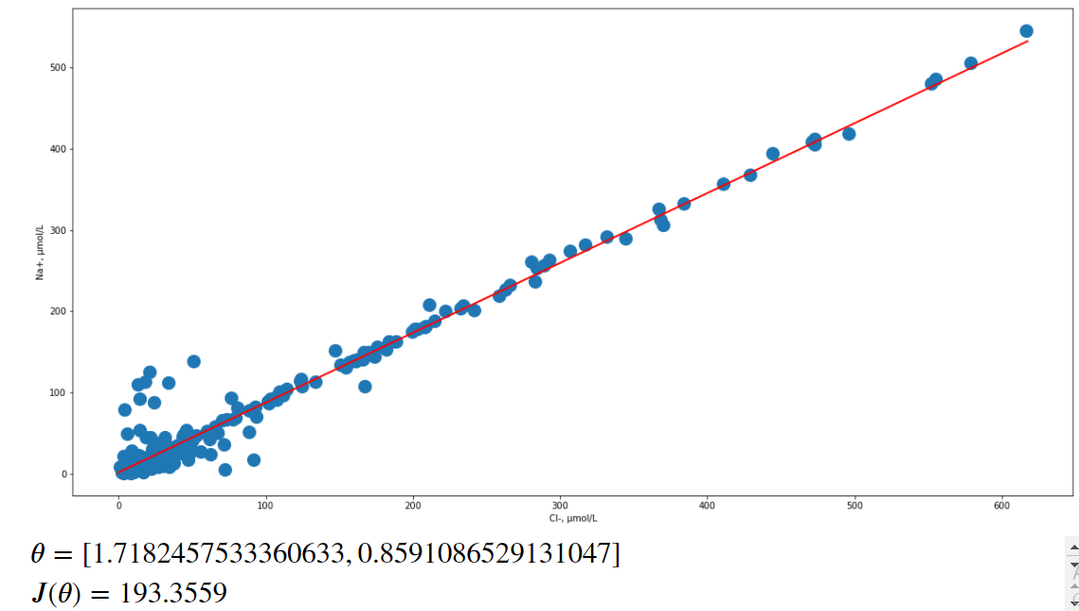
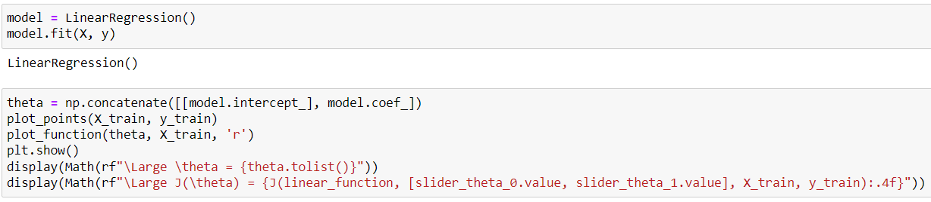
Define the Independent and Dependent Variable

Slide 30
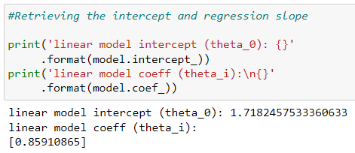
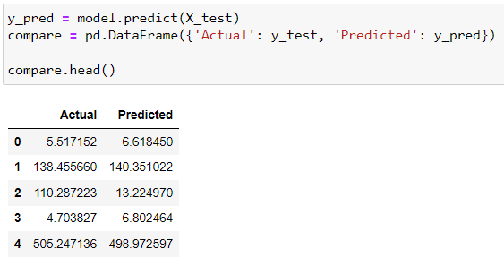
Define the Independent and Dependent Variable

Slide 31
Model Evaluation

Slide 32
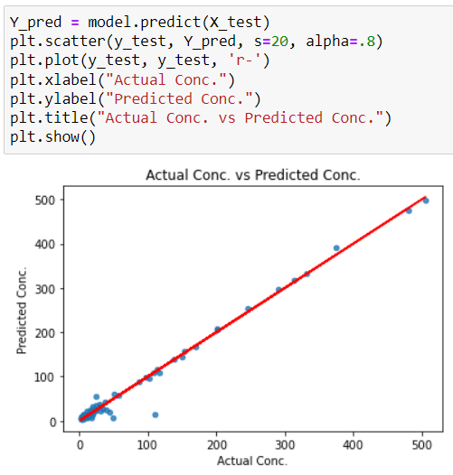
Compare the Actual data and the Predicted data

Slide 33
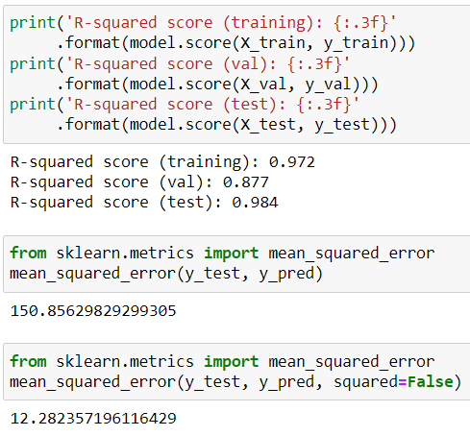
Look at R-squared, MSE and RMSE

Slide 34
Multivariable Linear Regression
Na⁺ vs Cl⁻ and Mg²⁺

Slide 35
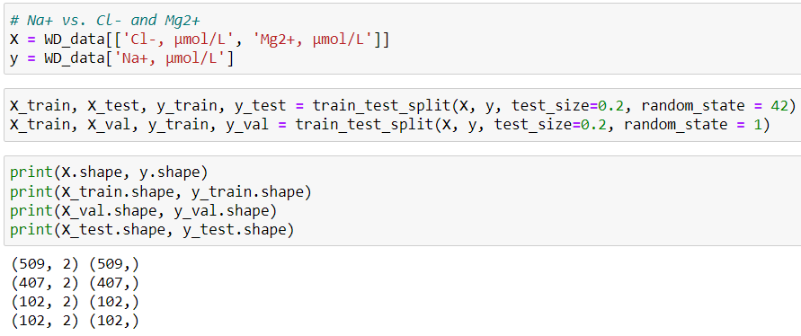
Define the Independent and Dependent Variable and Splitting the Dataset into Train, Validation and Test Set

Slide 36
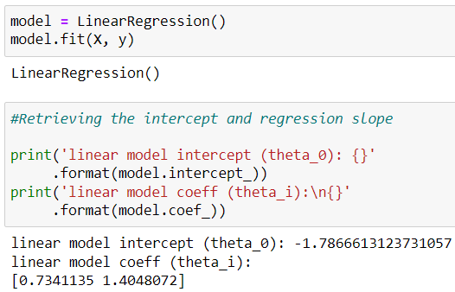
Linear Regression

Slide 37
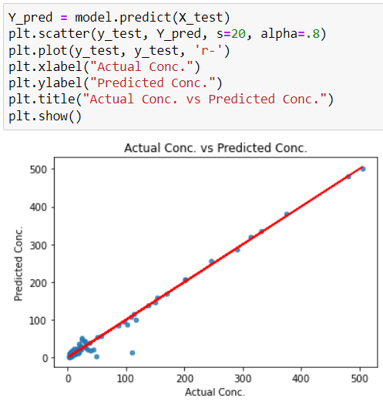
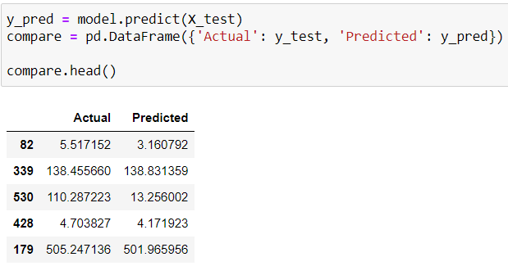
Compare the Actual data and the Predicted data

Slide 38
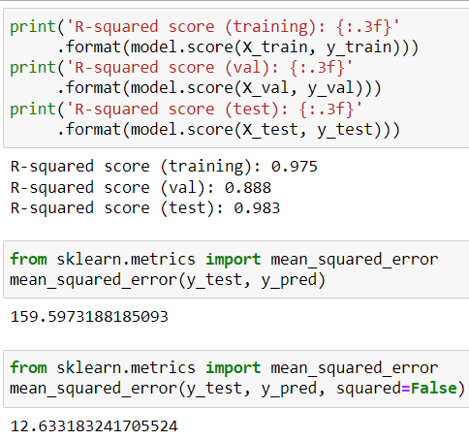
Look at R-squared, MSE and RMSE

Slide 39
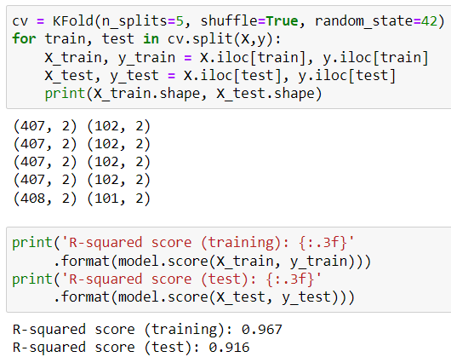
K-Fold Cross Validation

Slide 40
Comparison of R-squared, MSE and RMSE
Na⁺ vs. Cl⁻
Na⁺ vs. Cl⁻ and Mg²⁺

Slide 41
Conclusion
Based on the computed R-squared, MSE and RMSE, the linear regression generated using Chloride ion (Cl⁻) concentration alone is slightly better for predicting Sodium ion (Na+) concentration than using Chloride ion (Cl⁻) and Magnesium ion (Mg²⁺) concentrations. The generated linear regression explains about 98.4% of the variability.

Slide 42
Conclusion
• What problems are we able to solve using our algorithm?
- Re-analysis of samples whenever Sodium Ion quality checks failed the criteria
• How can we use it? With what tools to pass on to someone for
use?
- The algorithm can be passed using an excel file. Since the reporting format of the rainwater data is in excel.
• How to interpret the results of the algorithm?
- y = 0.85910865 + (1.7182457533360633)(x)
• How to interpret the algorithm performance results?
- there is a 98.4% correlation between sodium ion and chloride ion
• How can we improve it in the future?
- We can use the monthly data for each year and prepare separate algorithms for wet and dry season.

Slide 43
Thank you

